Slide 1

송치윤, 시용욱, 유상욱

Slide 2

home_icon.png
Motivation
Introduction
System Flow
Screenshots
Strength
Key techniques
Source Code
Demo
Difficulty
Role
Future Work
Index

Slide 3
Motivation
Is it really Smart ?
Smart Phone Era

Slide 4
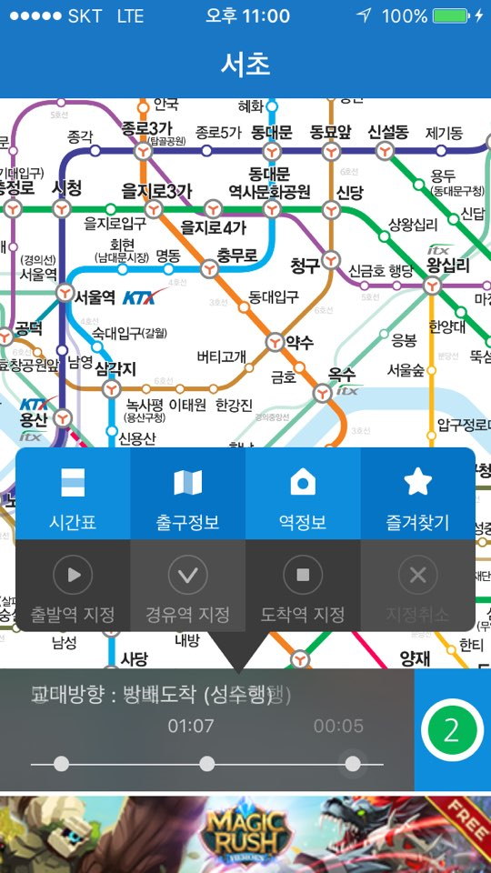
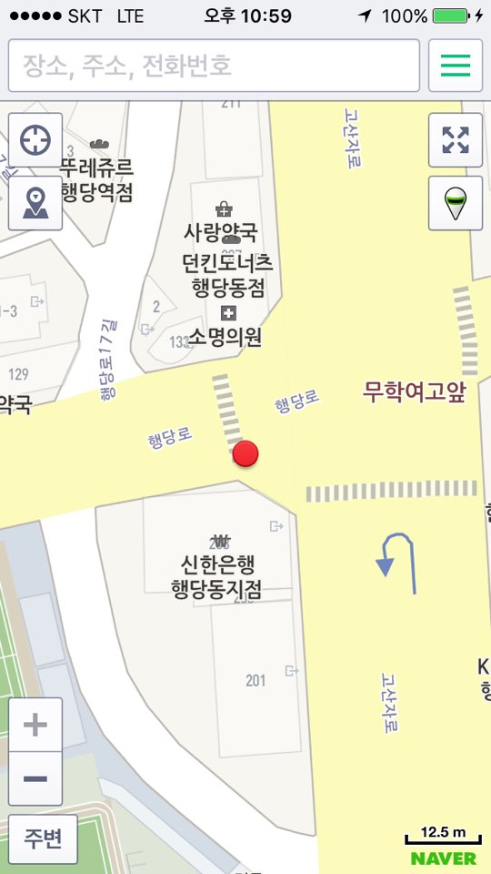
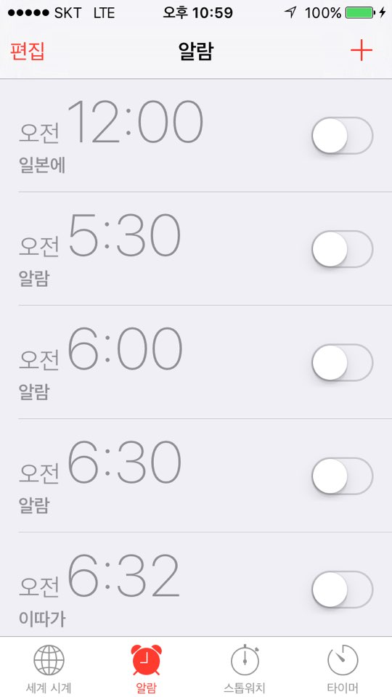
Motivation

Slide 5
Motivation
Make smart Phone smart
Make automatic alarm application which notify departure time to destination

Slide 6




Introduction
Set the destination
Set the curfew time
Choice the alarm music among user’s phone
Show the subway route to arrive destination

Slide 7
Introduction
Show the user’s current location in Google map
Notify the nearest subway station and connect user’s position
Inform the departure time

Slide 8
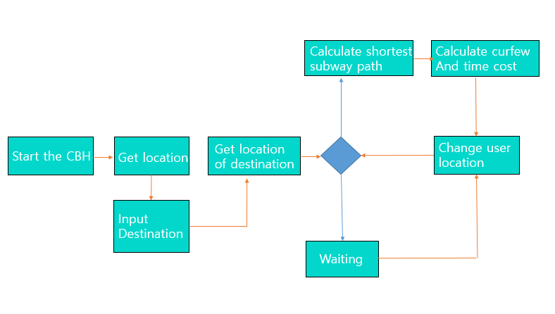
System Flow

Slide 9
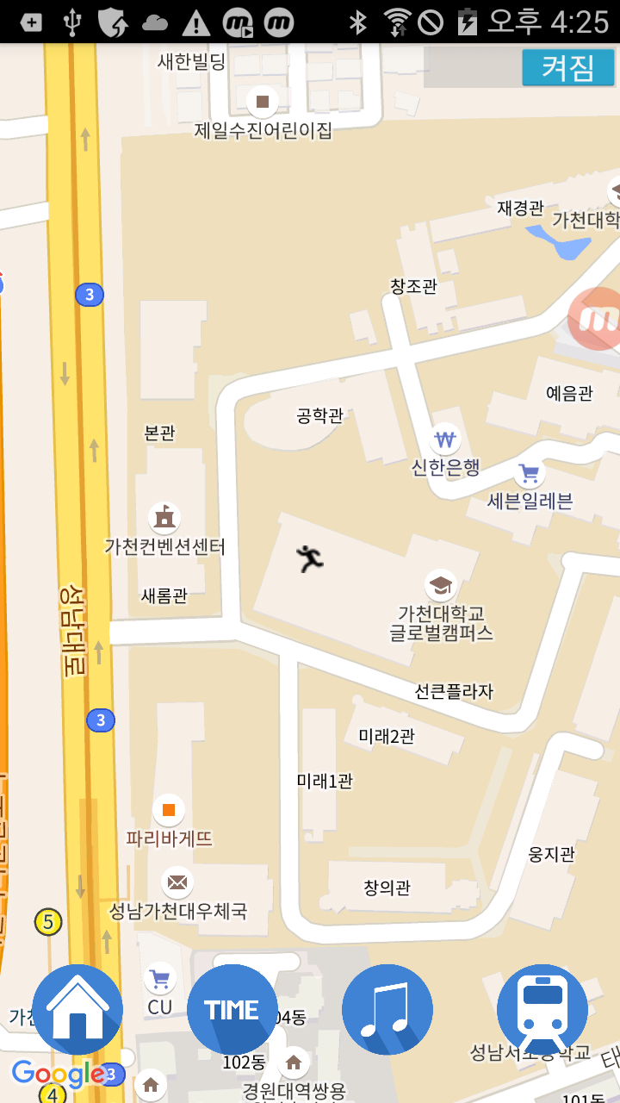
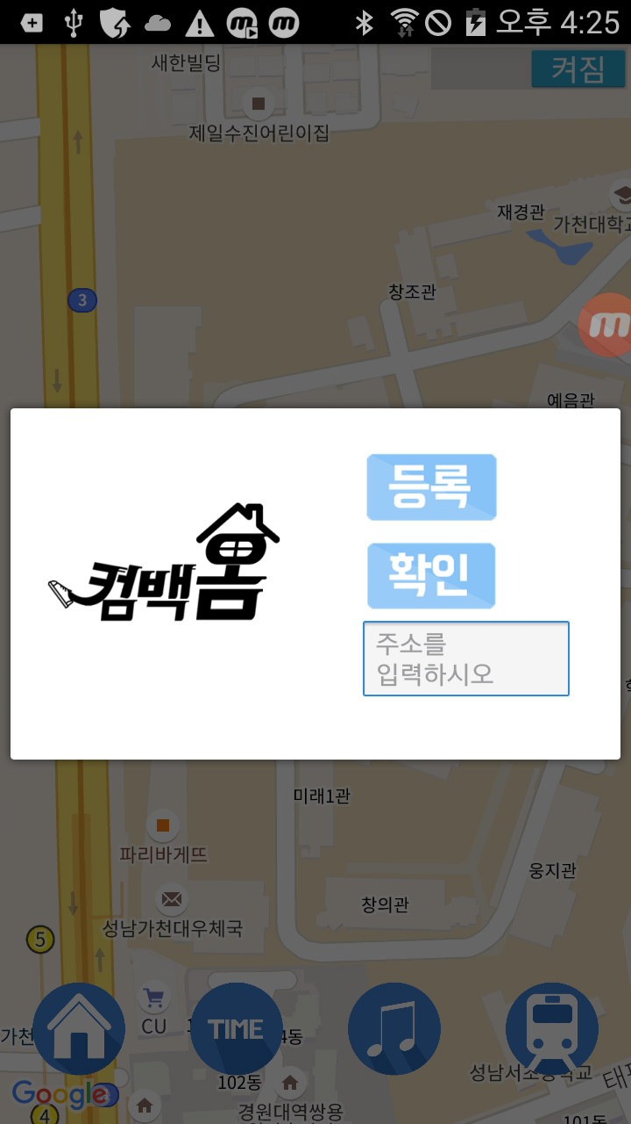
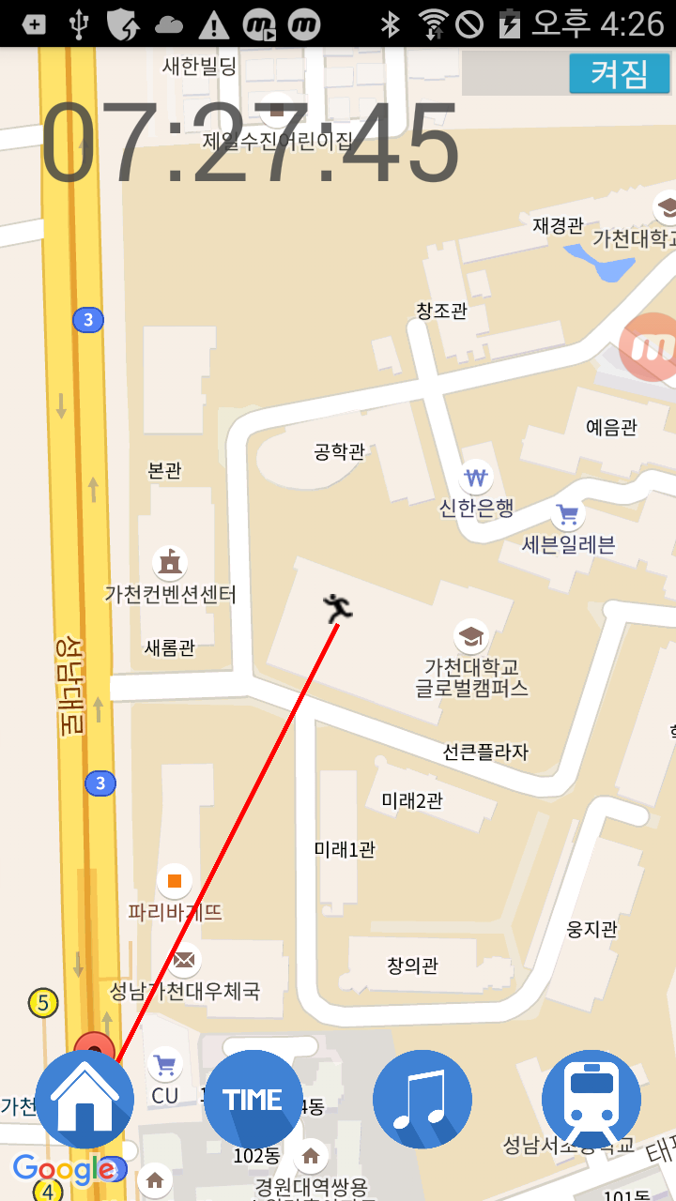
Screen Shot
1. Not set destination
2. Set destination
Complete to set destination

Slide 10
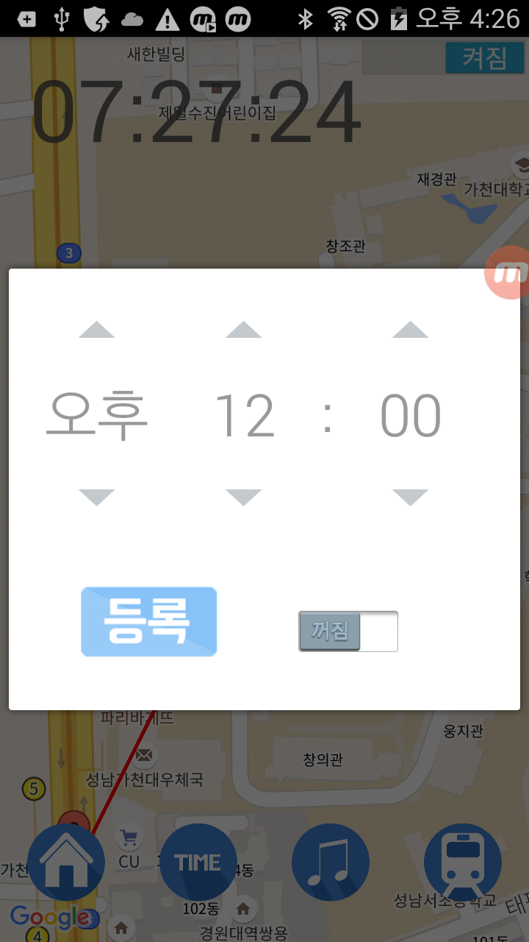
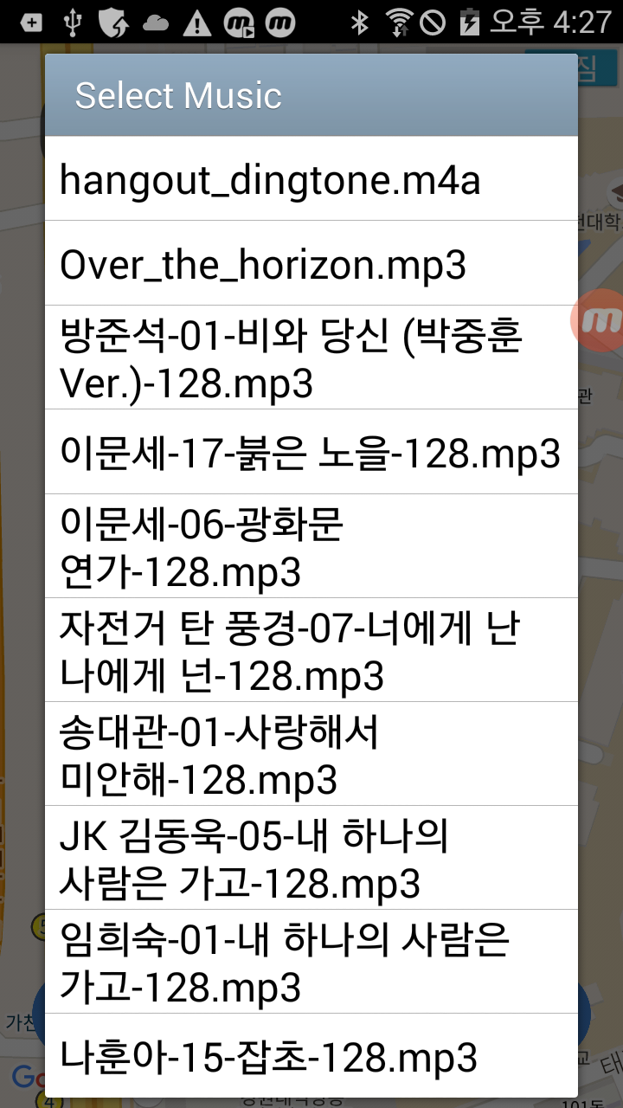
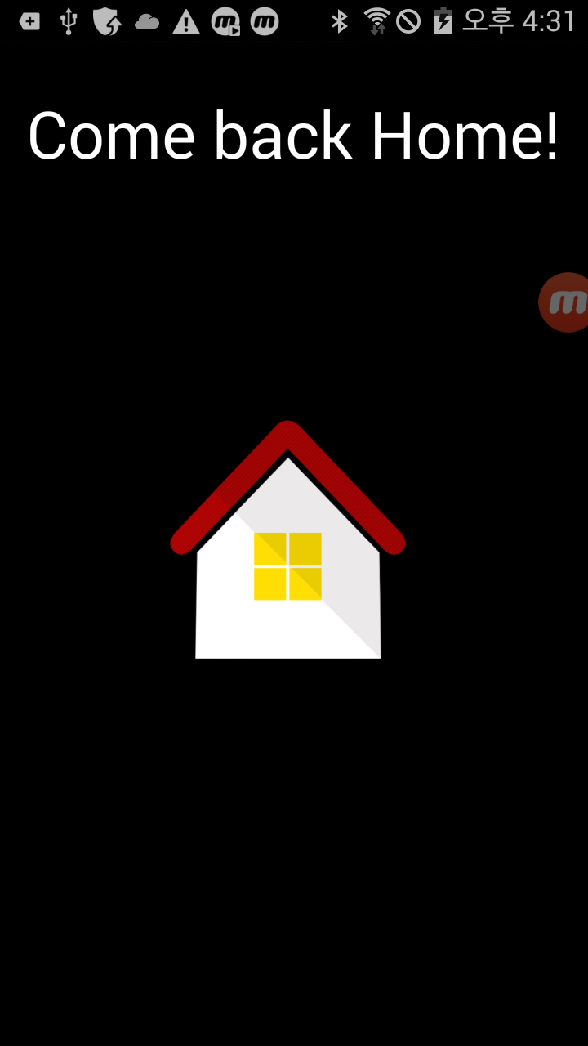
Screen Shot
4. Set curfew time
5. Select alarm music
6. Alarm

Slide 11
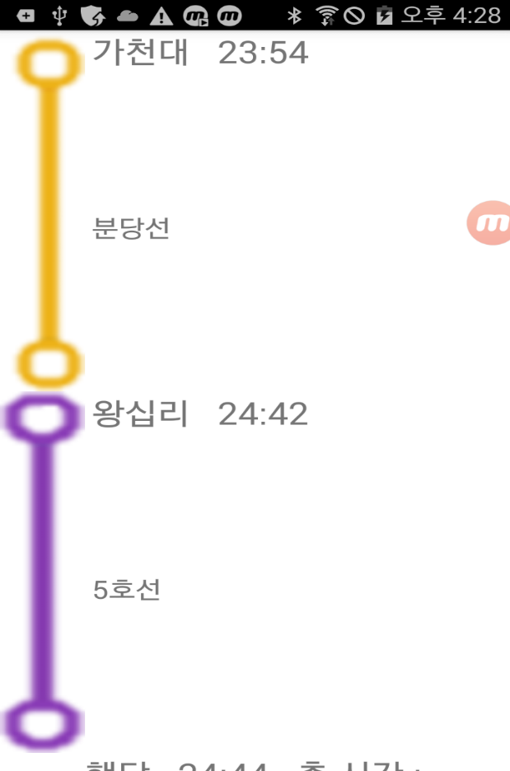
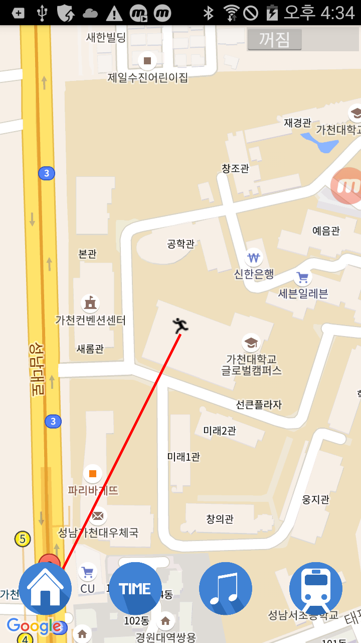
Screen Shot
7. Show subway route
8. Off the service

Slide 12
Strength
Automatically receive the alarm service which is based on user’s location
Because of using embedded data, user can receive the service through only using GPS (but can’t receive map service)
Can be used for other purpose

Slide 13
Key Techniques
Receive and split Subway data and store them in SQLite Database
Find shortest subway route by using Dijkstra algorithm.
Compute depart time(alarm time) by considering distance and time table of subway
Service component state should be changed along with the mode of application

Slide 14
Source Code

Slide 15
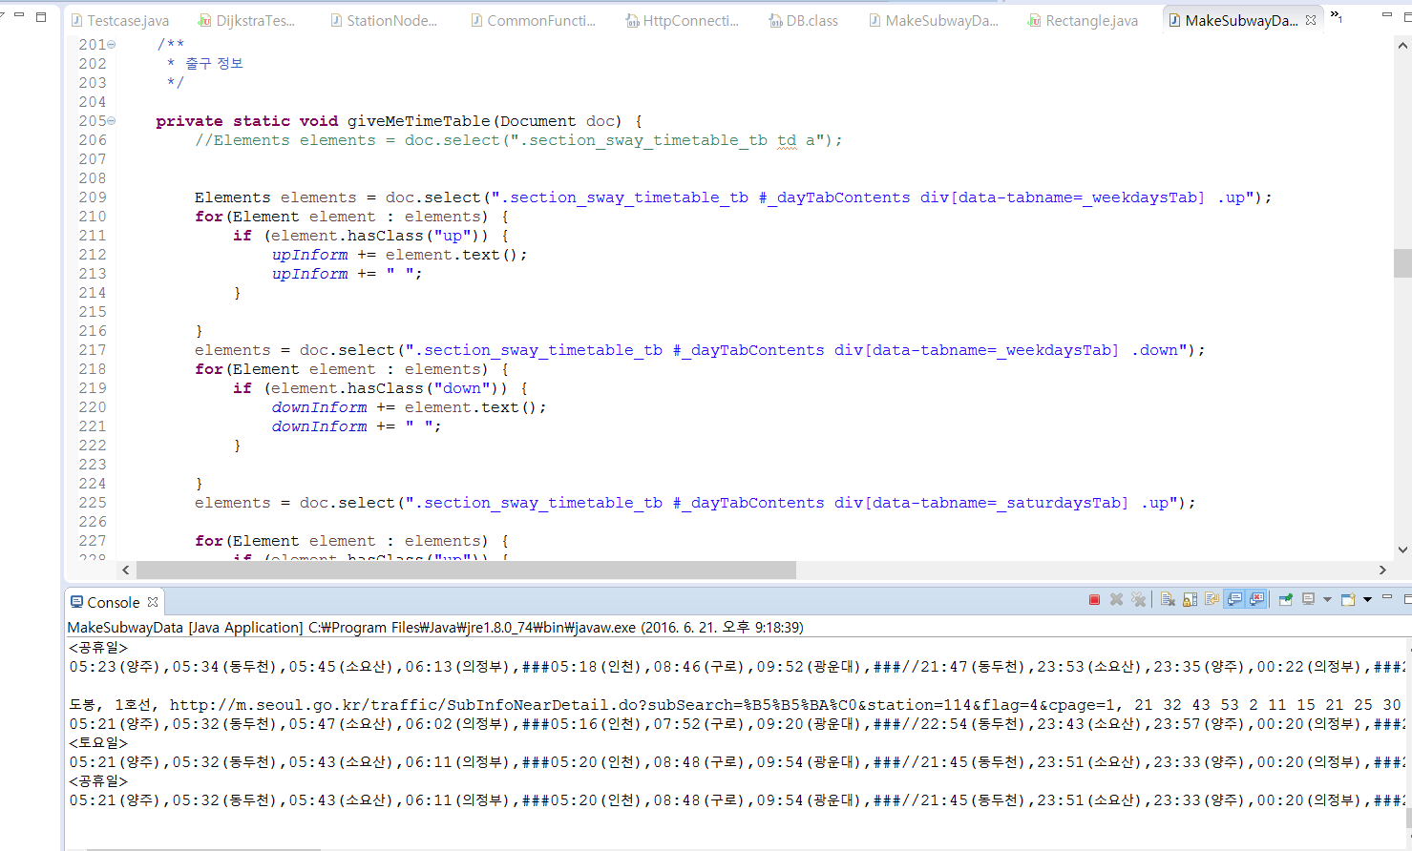
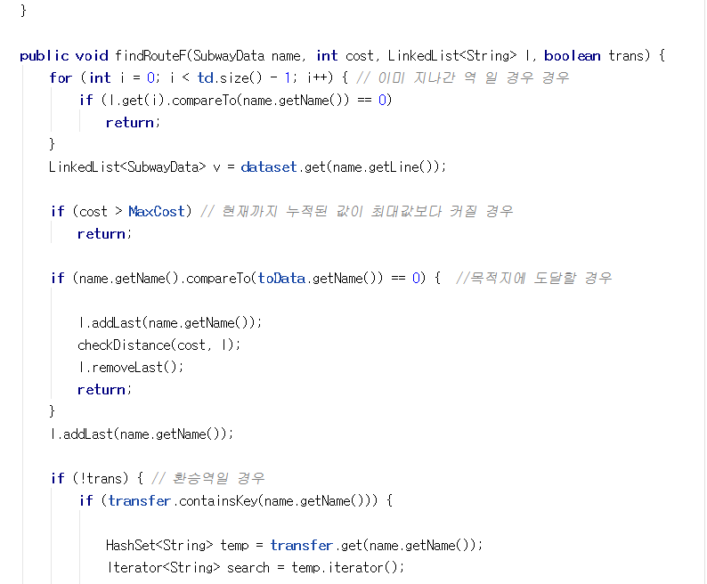
Source Code

Slide 16
Source Code

Slide 17
Demo
demo1

Slide 18
Difficulty
Select
Map API
Construct
DB
Fee-charge
Various style
Limited method
Useless API
Unstable data
Dijkstra
Time setting
Process data
Accuracy
Reduce Complexity
Find the most accurate time
Different last subway time

Slide 19
Role
시용욱
Construct SQLite DB
Implement Dijkstra algorithm
송치윤
Construct service and Connection
Integrate with each work in Service component
유상욱
Implement various functions (alarm, music list, Dialog, others)
Attach additional functions.
CHAPTER #02

Slide 20
Future Work
Add additional public transportation information
Extend market (대구, 부산..)
Maintain and update the public transportation information
Improve to compute more efficient route

Slide 21
Git Hub
https://github.com/Be-Programmer/CombackHome

Slide 22
THANKS

